Slide 1
Student Records Data Reporting Tools
Jose Lema – Student Success Systems Analyst jose.lema@sjsu.edu
Ravi Alladi – Data Warehouse ETL/BI Developer ravi.alladi@sjsu.edu
Ravi Pisupati – Tech Lead, Student Data Warehouse ravi.pisupati@sjsu.edu
Scott Heil – Director, Institutional Effectiveness and Analytics scott.heil@sjsu.edu

Slide 2
Accessing Student Records Data
Student Records Transactions Data Access For Reports
StarRez (Housing)
College Scheduler
Student Data Warehouse
PeopleSoft
Spartan Connect (EAB)
Other External Data Files (e.g. ERS, APDB)
SAMI
Canvas
eFaculty
Notes:
Student Data Warehouse – Historical Data for Planning and Administration
Spartan Connect EAB – Strategic Analytics including graduation rate predictions to identify at-risk students
SAMI – Admission review, enrollment and graduation rosters

Slide 3
Accessing Student Records Data - SDW
Student Data Warehouse
Trends Analysis, Aggregate, and individual record analysis
Grades
Degree Data
Cohort comparisons
Student group membership – i.e. demographics, EOP participation
Forward looking - Enrollment data (SmartPlanner)

Slide 4
Accessing Student Records Data - SAMI
SAMI
Application Data – including imaged documents
Enrollment Rosters by Program and course
Testing Data
Graduation Application and Degree Rosters

Slide 5
Accessing Student Records Data - EAB
Spartan Connect - EAB
Graduation Rates by attribute (i.e. degree progress metrics, demographics)
SJSU Course enrollment
Grades
Change of Major
Student Group Analysis

Slide 6
Student Data Warehouse – Reports Available
  Enrollment Planning
  Course Grade Distribution
  Student Success
  Student Profile
  Graduate Student Tracker
  SmartPlanner (in development)
  Contains PeopleSoft data from Fall 2005 – Present , updated nightly

Slide 7
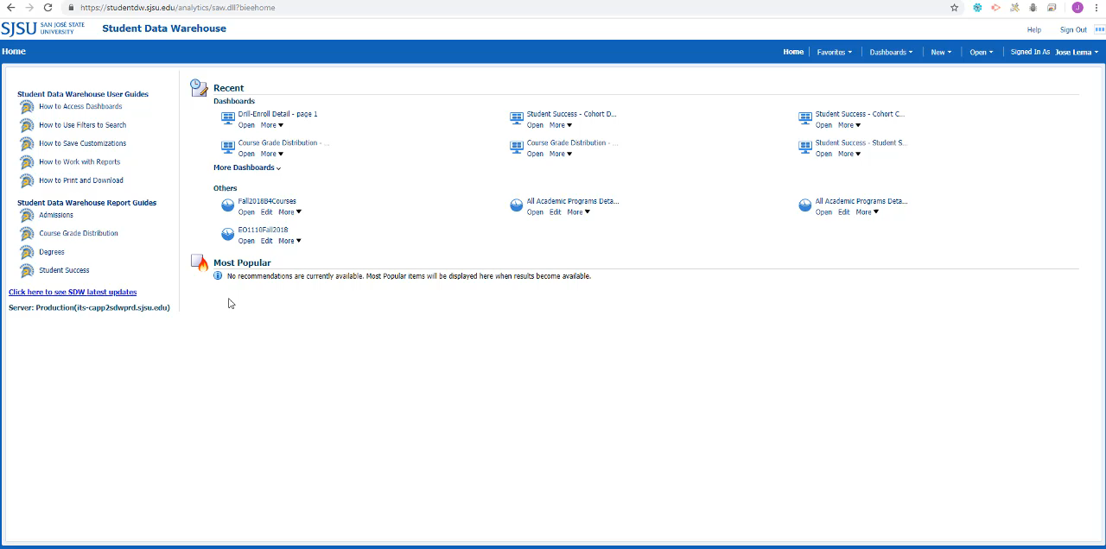

Slide 8
Student Data Warehouse - Training
In Person Training – including remote attendance via Zoom
Training Videos on the Student Data Warehouse Updates Page
PDF Tutorials
Open Labs
One on one meetings

Slide 9
Spartan Connect (EAB)
Grad Rate by Student Attribute
Grad Rate by Grade Earned or by total units earned during enrollment
Course Analysis – Grade Distribution by Standardized Test Score
Change of Major Analysis – Number of students changing from and to each major
Contains Fall 2006 – Fall 2012 cohorts

Slide 10
Data Reporting Priorities
Admission
Enrollment
Grading
Graduation

Slide 11
Questions?
Jose Lema – Student Success Systems Analyst jose.lema@sjsu.edu
Ravi Alladi – ETL/Business Intelligence Developer ravi.alladi@sjsu.edu
Ravi Pisupati – Tech Lead, Student Data Warehouse ravi.pisupati@sjsu.edu
Scott Heil – Director, Institutional Effectiveness and Analytics scott.heil@sjsu.edu

