Slide 1
Student Success Dashboards Deans and Chairs Student Data Warehouse Training, Session 3
Jose Lema – Student Success Business Analyst jose.lema@sjsu.edu
Ravi Alladi – Data Warehouse ETL/BI Developer ravi.alladi@sjsu.edu
Ravi Pisupati – Tech Lead, Student Data Warehouse ravi.pisupati@sjsu.edu
Scott Heil – Director, Institutional Effectiveness and Analytics scott.heil@sjsu.edu

Slide 2
Overview
Questions to explore using Student Success data
Quick Refresher of Dashboard layouts including prompts, report data, and filters
An introduction to the Course Grade Distribution, Student Success, Graduate Student Tracker, and Student Profile Dashboards
Q & A

Slide 3
Questions to Explore Using Student Success Data
In which courses have students been the most/least successful?
Which colleges/departments/courses/sections have the highest failure rates?
How have graduation rates varied across cohorts? (by admit term/majors/demographics)
How can I generate student and recent alumni contact lists?
How can I generate a current student list for a particular college/major?
Other questions?

Slide 4
Dashboards containing Student Success/Degree Progress Data
Course Grade Distribution Dashboard – Distribution of grades by course, college, department, and faculty member
Student Success Dashboard - Graduation and retention data by cohort
Graduate Student Tracker Dashboard - Graduate student degree progress data
Student Profile Dashboard – Individual student degree progress data (GPA, units earned, unofficial transcript)

Slide 5
Course Grade Distribution Dashboard
Grades by Section – Percentage of students earning each grade
Faculty View – Grade Distribution organized by faculty member
College Summary –Grade Distribution by Department and/or College
High Failure Rate Courses – Identifies courses by failure rate percentage – (WU, NC, F, D-, D, D+ grades)
Academic Standing Report – count of students in each Academic Standing status by term

Slide 6
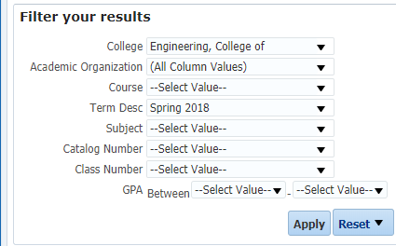
Course Grade Distribution Grades by Section
Percentage of each grade awarded by section.
May be filtered by college, department, term, course subject

Slide 7
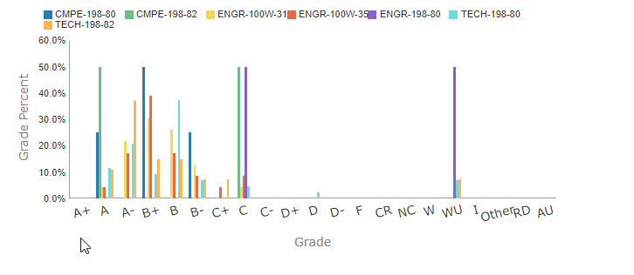
Course Grade Distribution Grades by Section
Sort by Faculty, then use the drill down to see all sections taught by the faculty member

Slide 8
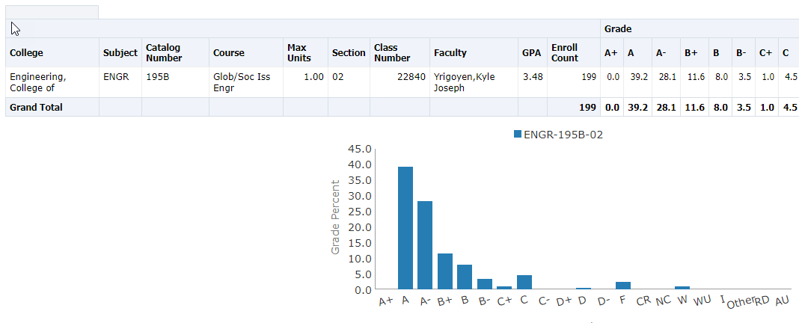
Course Grade Distribution Faculty View
Course grades organized by faculty member.
Histogram shows distribution for the selected course and term

Slide 9
Student Success Dashboard
Cohort Comparison – Graduation and retention rates by cohort
Cohort Details – Degree progress data aggregation by multiple demographic dimensions and academic background
Student Search – Individual student degree progress information
Comparison by Cohort Type – focus on students in the 2.2 – 2.5 GPA range. Graduation rates by major and academic level.

Slide 10
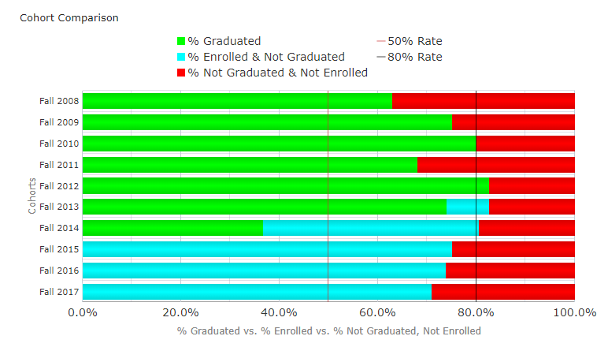
Student Success Dashboard – Cohort Comparison
Cohort Comparisons by may be filtered and/or sliced by College, Ethnicity, Parent’s highest education level, or CA residency for tuition purposes.

Slide 11
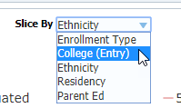
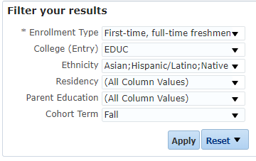
Student Success Dashboard – Cohort Comparison
Use the Slice By drop down menu to examine graduation data based on demographic data
Filter the data using the prompts on the
left.

Slide 12
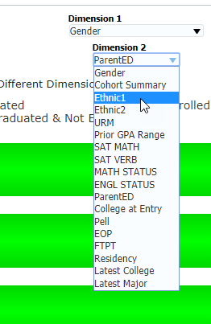
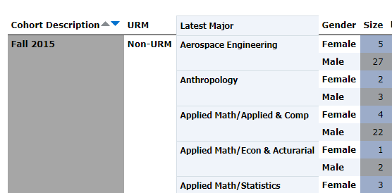
Student Success Dashboard Cohort Details
Tracks enrollment and graduation status of students by cohort and demographics

Slide 13
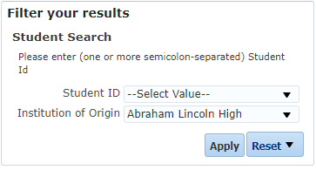
Student Success Dashboard Student Search
Search for specific students by Student ID number or by Institution of Origin
Contains degree progress information, demographics, contact information and majors (at entry and latest major)

Slide 14
Graduate Student Tracker - Detail
Identifying Information/Demographics: SJSU ID, Name, Gender, Ethnicity, Visa Permit Type, Residency (for tuition purposes)
Contact Details: Preferred E-mail
Enrollment: Academic Program, Last Term Attended, College, Plan Code This Term
Academic Performance/ Degree Progress: Grad App Status, Leave Indicator, Term Units Attempted, Term Units Earned, Cumulative Units Earned, Cumulative GPA

Slide 15
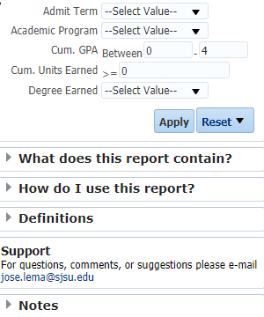
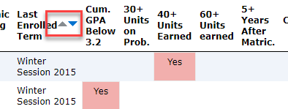
Graduate Student Tracker Summary
Information about the report

Slide 16
Graduate Student Tracker Summary
Identifying Information: SJSU ID, Name
Contact Details: Preferred E-mail, Phone
Enrollment: Major, College, Last Enrolled Term, Degree Earned
Academic Performance/ Degree Progress: GPA, Units Earned, Indicators: GPA Below 3.2, 30+ Units on Prob., 40+ Units Earned, 60+ Units Earned, 5+ Years After Matric

Slide 17
1290R Report
Lists students who have completed all required coursework but still need to complete culminating experience thesis or project
Identifying Information: SJSU ID, Name
Demographics: Residence for tuition purposes, Visa permit type
Contact Details: Preferred E-mail, Phone
Enrollment: Term Description (of semester taking 1290R), Subject Code, Subject Description

Slide 18
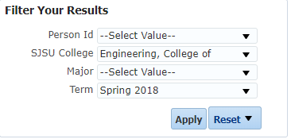
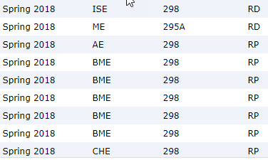
Graduate Student Tracker Incomplete Grade Report
Listing of ungraded incomplete courses with grades I, IC, RD, RP, IP
May be filtered by Term, College, and Major

Slide 19
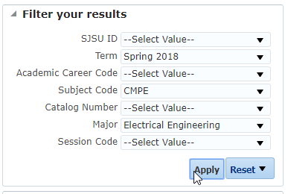
Graduate Student Tracker Major and Course Prefix Search Report
Lists coursework for students taking courses in a particular subject and may be filtered by major, term, and career

Slide 20
Student Profile Dashboard
Display individual student degree progress, GPA, units earned trends and unofficial transcript, some demographic data

Slide 21
Additional Training and Support
Monthly Brown Bag Lunch Sessions to share best practices with other advisors, offer feedback on new features/enhancements (monthly 11:00 AM - 12:00 PM in Clark 505)
E-mail jose.lema@sjsu.edu to schedule a one-on-one appointment or small group session.
To Request Access to the Dashboard, complete the form located at Student Data Warehouse Access Request
Student Data Warehouse Blog
Review User Guides and information on the left panel of the dashboards

Slide 22
Questions?
Jose Lema – Student Success Business Analyst jose.lema@sjsu.edu
Ravi Alladi – ETL/Business Intelligence Developer ravi.alladi@sjsu.edu
Ravi Pisupati – Tech Lead, Student Data Warehosue ravi.pisupati@sjsu.edu
Scott Heil – Director, Institutional Effectiveness and Analytics scott.heil@sjsu.edu

